Slide 1
Bayesian Approaches to Surrogate-Assisted Evolutionary Multi-objective Optimization: A Comparative Study
Chaoli Sun
Department of Computer Science and Technology,
Taiyuan University of Science and Technology
chaoli.sun.cn@gmail.com, chaoli.sun@tyust.edu.cn

Slide 2
Outline
Optimization and models
Evolutionary Bayesian optimization
Bayesian evolutionary optimization
Experimental studies
Conclusion

Slide 3

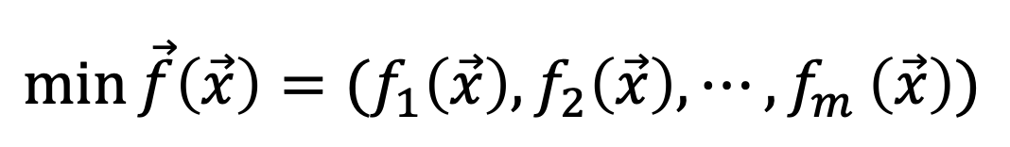
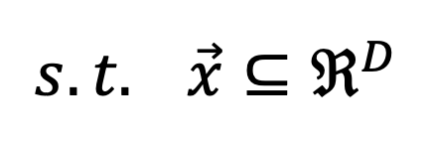
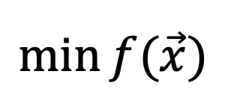
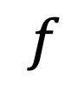
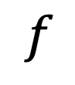
Optimization
Optimization problems
Single-objective problems
$$f$$
is continuous
$$\min{f(\vec{x})}$$
$$f$$
is expensive to evaluate
$$s.t. \vec{x}⊆ℜ^{D}$$
Multi-objective problems
$$f$$
is blackbox function
$$\min{\vec{f}\left(\vec{x}\right)=(f_{1}\left(\vec{x}\right),f_{2}\left(\vec{x}\right),⋯{,f}_{m}\left(\vec{x}\right))}$$
$$s.t. \vec{x}⊆ℜ^{D}$$

Slide 4
Optimization
Deterministic optimization algorithms
Gradient descent method
Newton’s method
Quasi-Newton method
……
Meta-heuristic optimization algorithms
Evolutionary algorithms
Swarm optimization algorithms
……

Slide 5
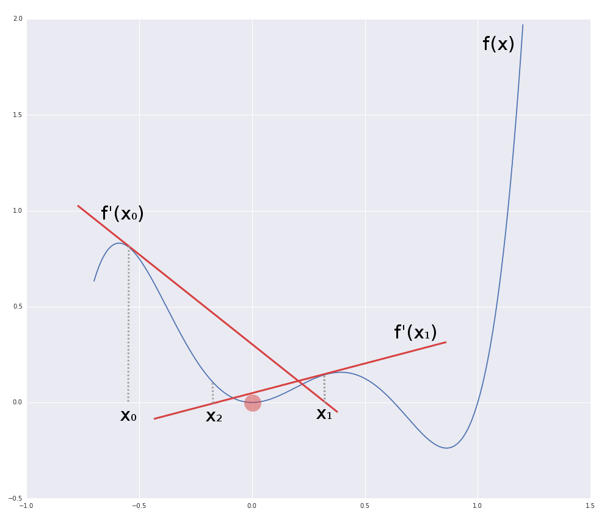
Initialize
Parent
Terminate
Recombine
Select
Mutate
Offspring
Evaluate
Initialize
Positions
Strategy for updating the positions
Terminate
New positions
Best position
Advantages & Disadvantages
Evaluate

Slide 6
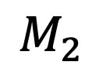
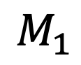
Models
Polynomial regression
Find the optimal solution by correcting the model using the infill criteria
Data
Neural network
Gaussian process
The model is used to assist meta-heuristic to search a promising region that the optimal solution may locate at.
$$M_{2}$$
$$M_{1}$$

Slide 7
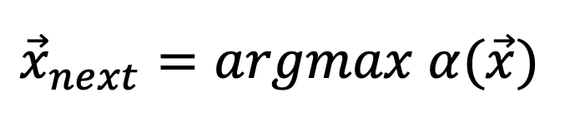
Bayesian optimization
Initial data and train a GP model
Get a posterior measure over some observations based on the samples and likelihood
Use the posterior to decide where to take the next evaluation according to some acquisition
$${\vec{x}}_{next}=argmax α(\vec{x})$$
Augment data and train a GP model

Slide 8
Bayesian optimization
Acquisition function
Lower confidence bound
Expected improvement
Maximum probability of improvement
……
[1] https://www.youtube.com/watch?v=C5nqEHpdyoE

Slide 9
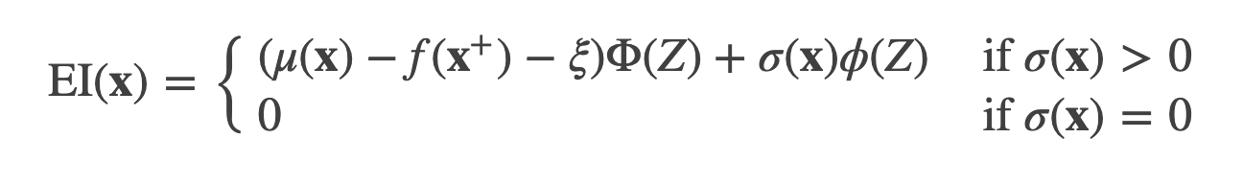
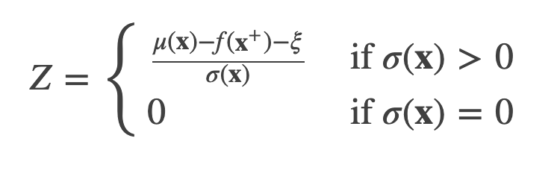
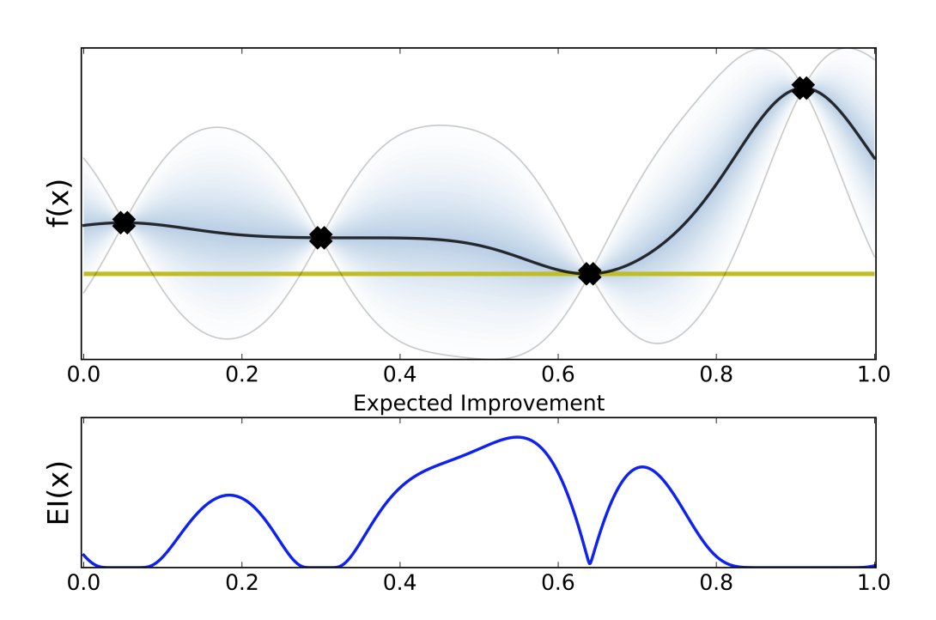
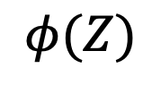
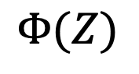
Expected improvement
$$Φ(Z)$$
: CDF of the standard normal distribution
$$φ(Z)$$
: PDF of the standard normal distribution

Slide 10
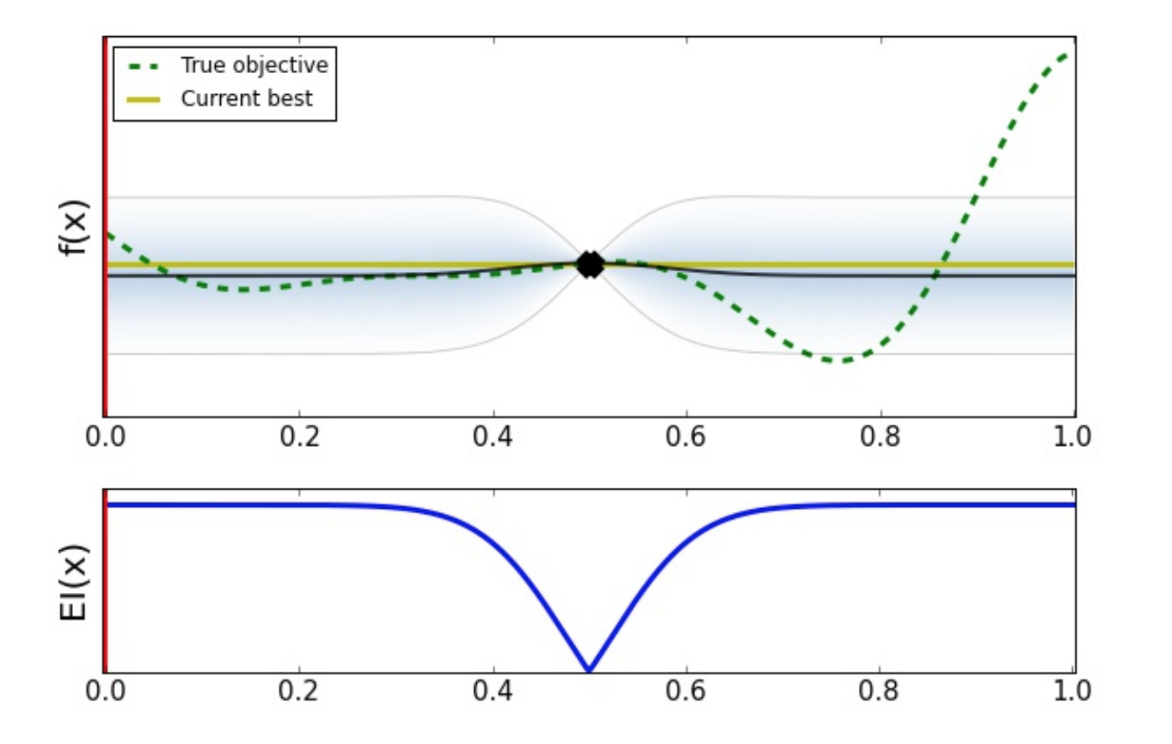
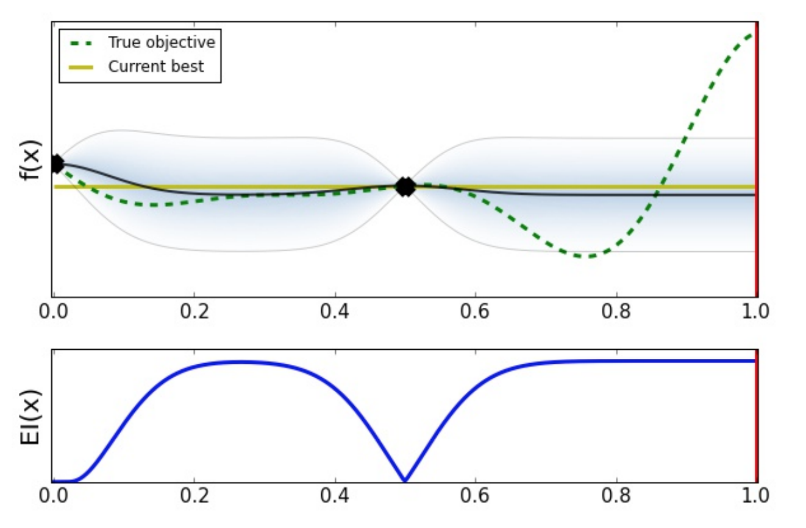
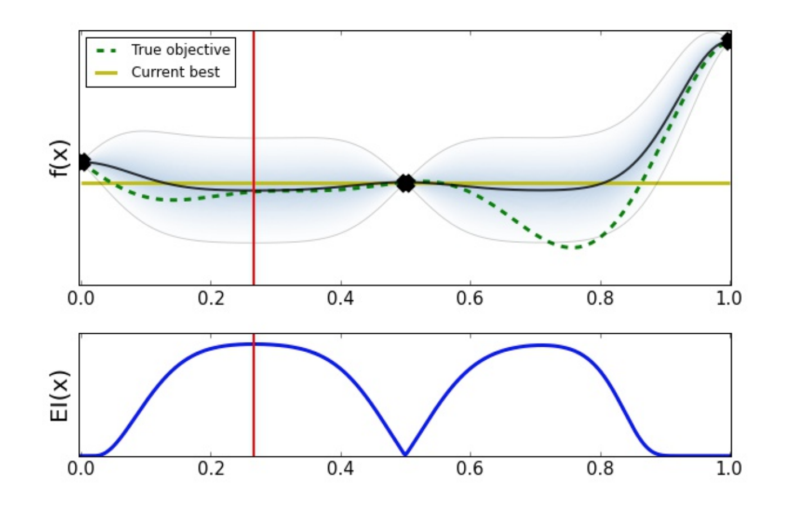
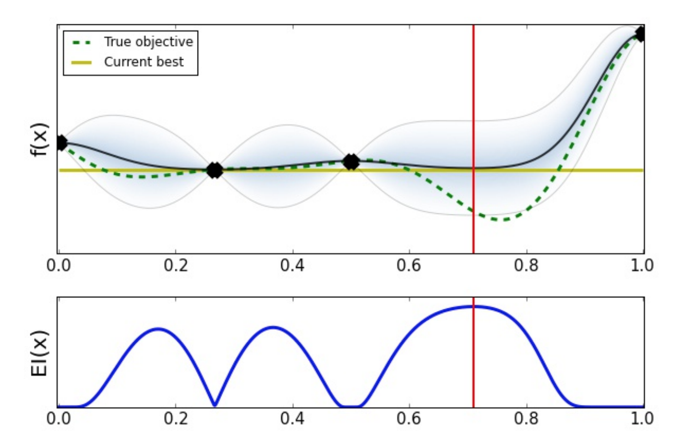
http://gpss.cc/gpmc17/slides/LancasterMasterclass_1.pdf

Slide 11
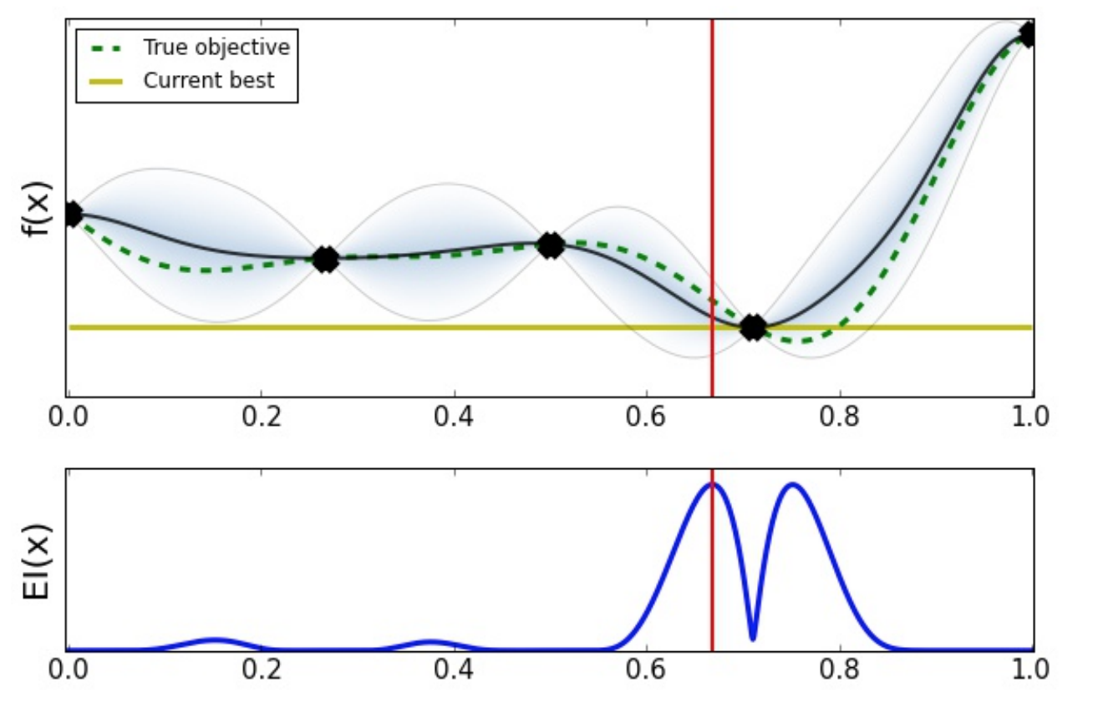
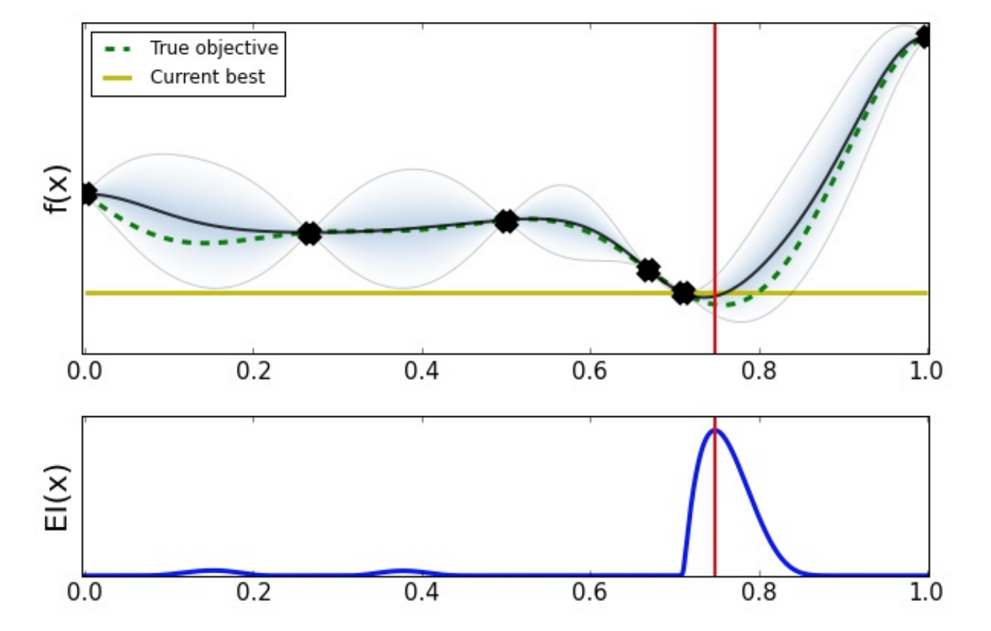
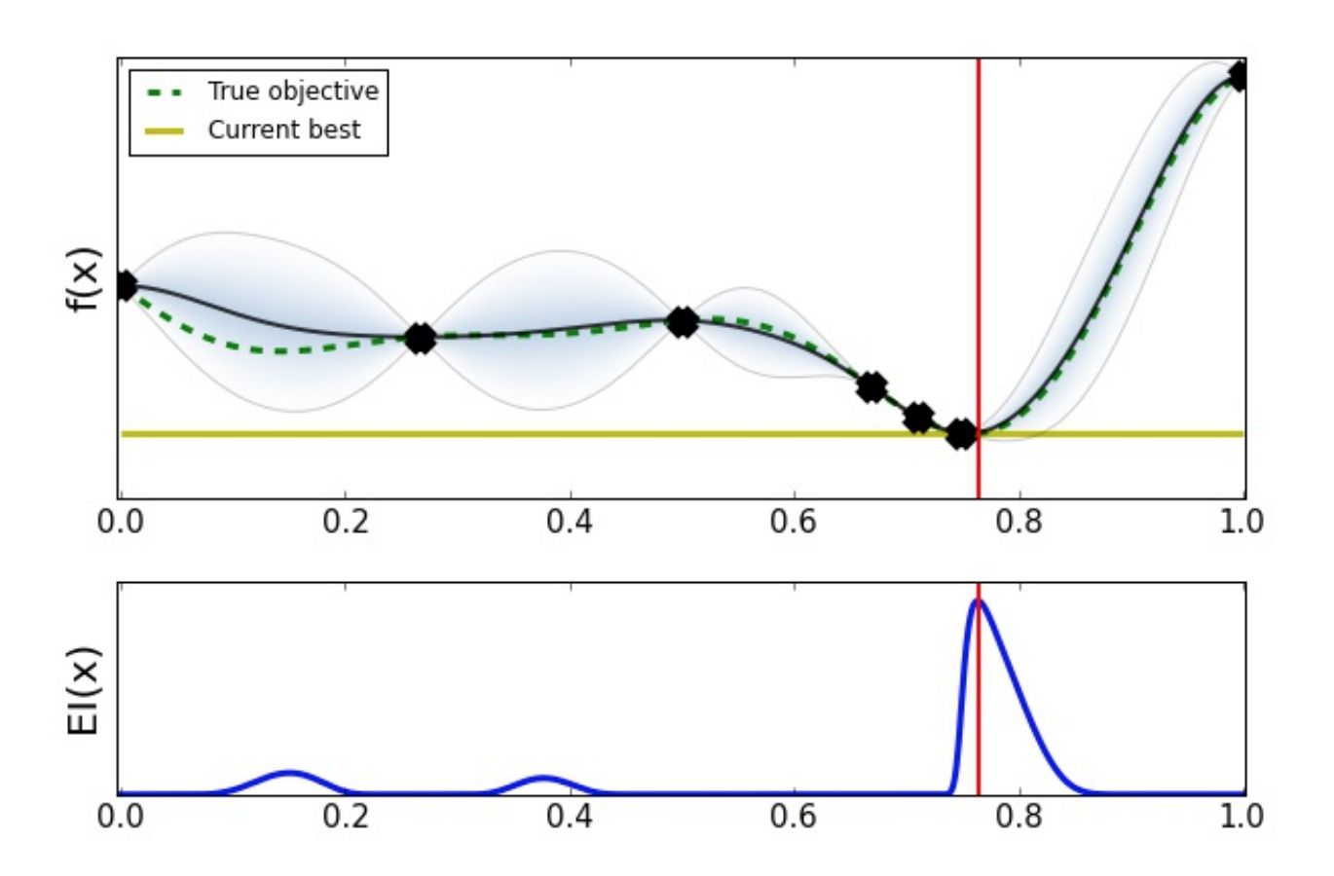
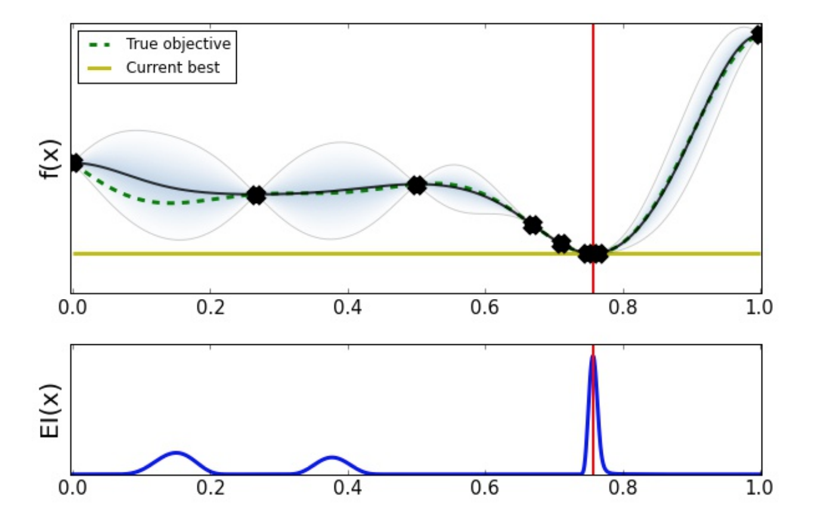

Slide 12
Bayesian optimization
Optimization of the acquisition function
Determination optimization algorithms
Meta-heuristic optimization algorithms

Slide 13
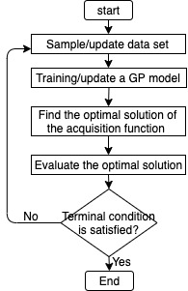
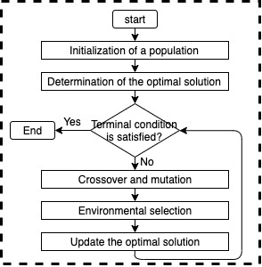
Evolutionary Bayesian optimization (EBO)

Slide 14
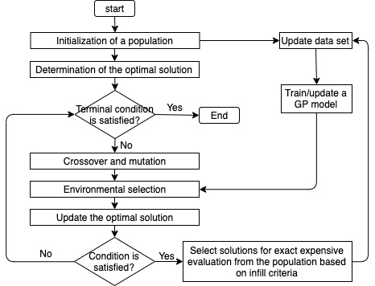
Bayesian evolutionary optimization
Model management

Slide 15
Similarity and differences
Similarity
Both of them are used for solving computationally expensive problems or black-box problems
Both of them utilize the Bayesian model and evolutionary algorithm
Use similar infill criteria to select solutions for exact evaluation

Slide 16
Similarity and differences
Differences
 | EBO | BEO
1 | Evaluate the position where the value of acquisition function is optimal | Evaluate the position where the value of acquisition function is best among the population

Slide 17
Similarity and differences
Differences
 | EBO | BEO
2 | The optimal solution of the expensive function is obtained by keeping on finding the optimal solution of acquisition function. | The optimal solution of the expensive function is obtained by searching the region where the optimal mean approximated value of the model allocates.

Slide 18
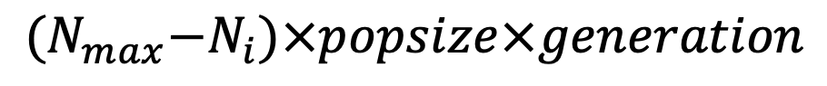
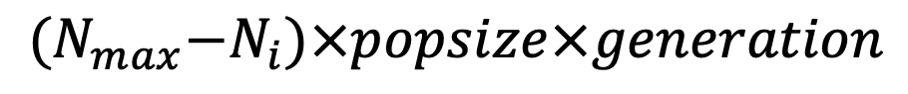

Similarity and differences
Differences
 | EBO | BEO
3 | The EA is expected to convergence before each exact evaluation. The computational complexity is | The EA is not expected to convergence before each exact evaluation. The computational complexity is not more than
$${(N}_{max}−N_{i})×popsize×generation$$
$${(N}_{max}−N_{i})×popsize×generation$$

Slide 19
Similarity and differences
Differences
 | EBO | BEO
4 | In the environmental selection, the offspring population is selected according to the value of acquisition function. | In the environmental selection, the offspring population is selected according to the mean approximated value.

Slide 20
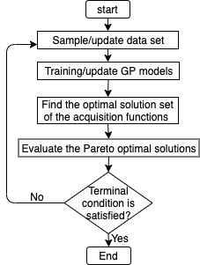
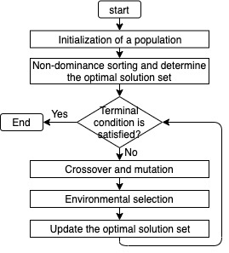
Evolutionary Bayesian optimization (EBO)

Slide 21
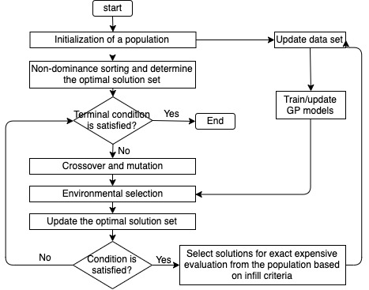
Bayesian evolutionary optimization
Model management

Slide 22
Model management
Training samples
All solutions which have been evaluated using the expensive function
When for exact evaluation
After 20 generations
Which for exact evaluation

Slide 23
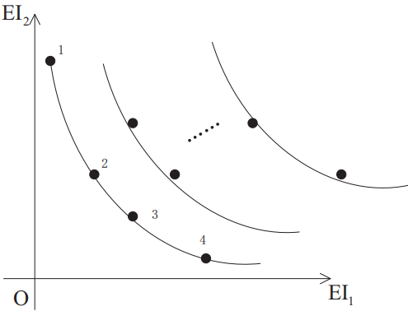
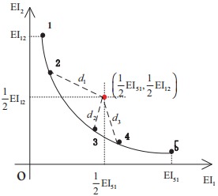
Model management
Training samples
When for exact evaluation
Which for exact evaluation

Slide 24
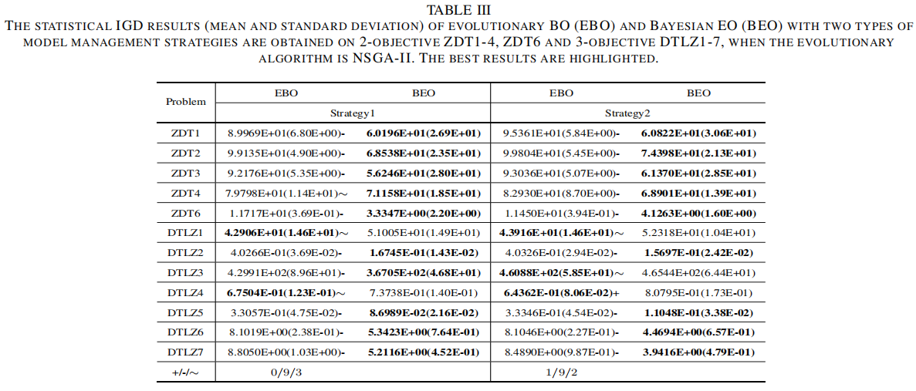
Experimental studies

Slide 25
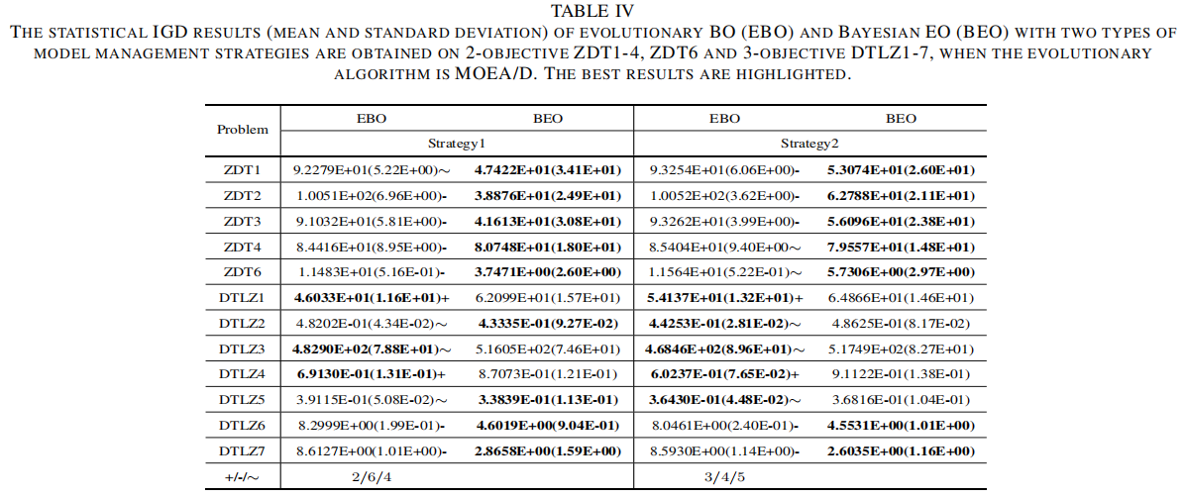
Experimental studies

Slide 26
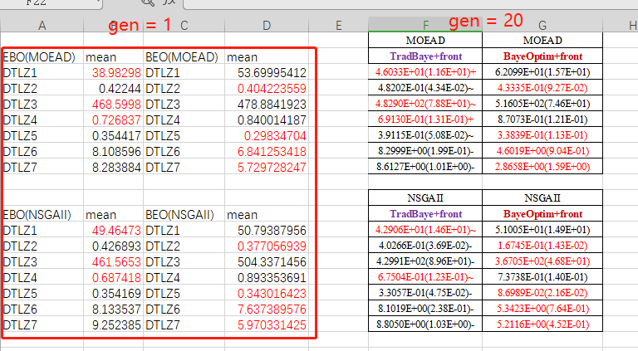
Experimental studies

Slide 27
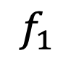

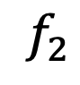
Experimental studies
$$f_{2}$$
$$\vec{w}$$
$$f_{1}$$

Slide 28
Conclusion
Two approaches using the GP model and meta-heuristic algorithms are compared.
Give an information on the way to use the model.
BEO is more efficient than EBO for time-consuming multi-objective optimization problems to some degree, but more studies are required to further confirm the conclusion.

Slide 29
Thanks!
Please contact Chaoli Sun (chaoli.sun.cn@gmail.com) by email if you have any question or comments!

